Slide 1

DATA STRUCTURES AND ALGORITHMS (113215)
Dr. Owais Hussain

Slide 2

Agenda
Trees
Binary Trees
Memory Representation
Operations
Binary Search Tree
Complexity Analysis
In Real Life

Slide 3
Sample 2
Trees
In data structures, Tree is a non-sequential ADT. Just like Linked Lists, it is a collection of Nodes
The starting node is called Root node, and it is connected to further nodes called Child nodes.
Child nodes can also have further child nodes, but nodes with no children are called Leaf nodes.
Nodes which share the same parent are called Siblings. Child of child node is called Descendent, and parent of parent node is called Ancestor.
Depth of a node is its distance from Root node while Height of the tree is distance from Root to Leaf nodes.
Subtree is any node along with its descendent nodes.
Notes:
Trees are non-sequential or non-linear because they are stored in multiple levels, and thus are called hierarchical data structures.

Slide 4
Sample 2
Trees
Trees have a variety of applications, like decision trees to dictionaries to version control repositories to games. But in a nutshell, they are used to:
Maintain data in hierarchical structure.
Making data search faster than linear time.
Managing sorted data.

Slide 5
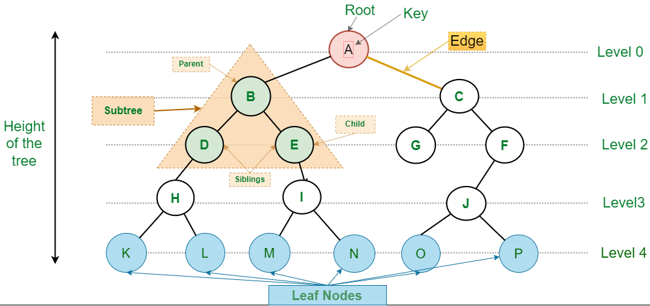
Sample 2
Trees
Notes:
Attribution: GeekForGeeks.com

Slide 6
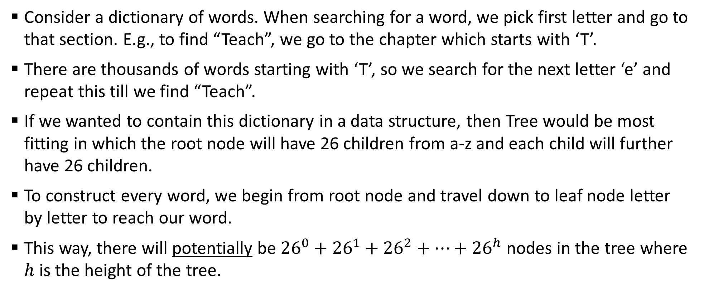
Sample 2
Trees
Consider a dictionary of words. When searching for a word, we pick first letter and go to that section. E.g., to find “Teach”, we go to the chapter which starts with ‘T’.
There are thousands of words starting with ‘T’, so we search for the next letter ‘e’ and repeat this till we find “Teach”.
If we wanted to contain this dictionary in a data structure, then Tree would be most fitting in which the root node will have 26 children from a-z and each child will further have 26 children.
To construct every word, we begin from root node and travel down to leaf node letter by letter to reach our word.
This way, there will potentially be ${26}^{0}+{26}^{1}+{26}^{2}+…+{26}^{h}$ nodes in the tree where $h$ is the height of the tree.
Notes:
Potentially, because a dictionary does not contain every possible combination. E.g. no word starts with “vx”

Slide 7
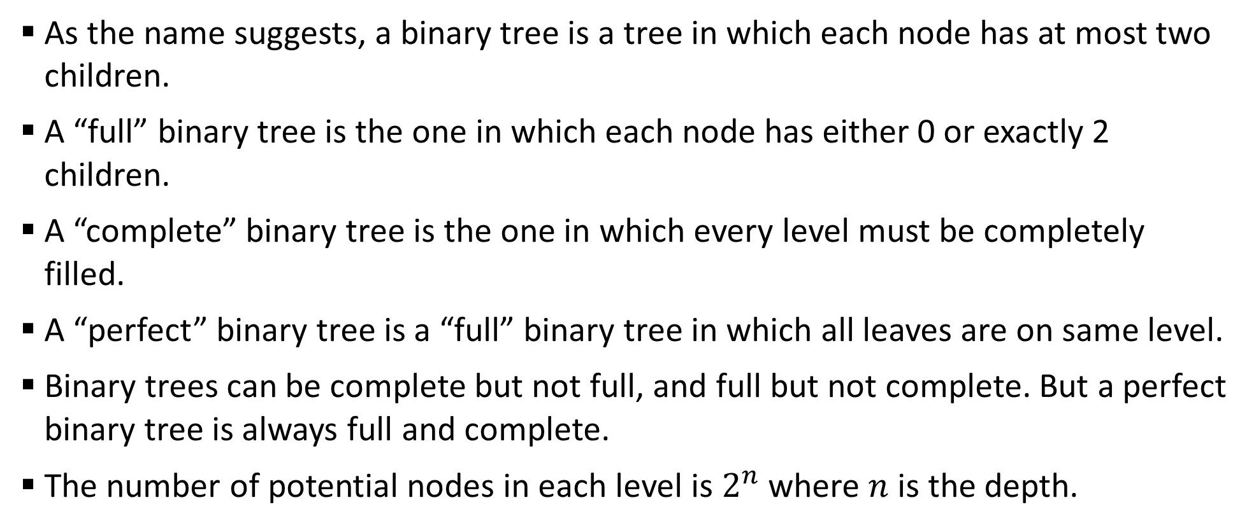
Sample 2
Binary Trees
As the name suggests, a binary tree is a tree in which each node has at most two children.
A “full” binary tree is the one in which each node has either 0 or exactly 2 children.
A “complete” binary tree is the one in which every level must be completely filled.
A “perfect” binary tree is a “full” binary tree in which all leaves are on same level.
Binary trees can be complete but not full, and full but not complete. But a perfect binary tree is always full and complete.
The number of potential nodes in each level is $2^{n}$ where $n$ is the depth.

Slide 8
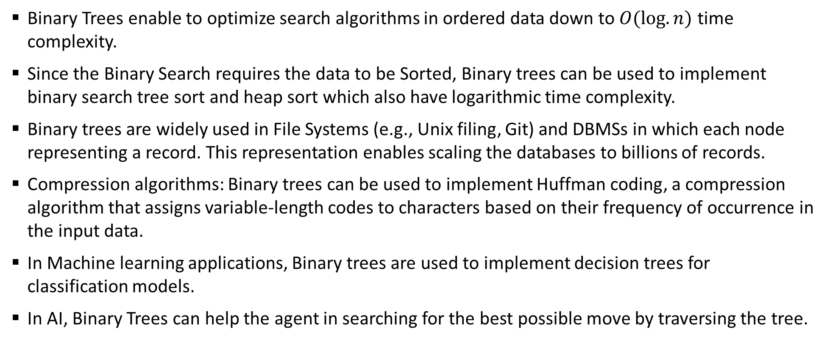
Sample 2
Binary Trees
Binary Trees enable to optimize search algorithms in ordered data down to $O(log.n)$ time complexity.
Since the Binary Search requires the data to be Sorted, Binary trees can be used to implement binary search tree sort and heap sort which also have logarithmic time complexity.
Binary trees are widely used in File Systems (e.g., Unix filing, Git) and DBMSs in which each node representing a record. This representation enables scaling the databases to billions of records.
Compression algorithms: Binary trees can be used to implement Huffman coding, a compression algorithm that assigns variable-length codes to characters based on their frequency of occurrence in the input data.
In Machine learning applications, Binary trees are used to implement decision trees for classification models.
In AI, Binary Trees can help the agent in searching for the best possible move by traversing the tree.

Slide 9
Sample 2
Binary Trees
Full
1
2
1.1
1.2
2.2
1.1.2
1.1.1
2.2.2
2.2.1
2.1.2
2.1.1
2.1
Complete
1
2
1.1
1.2
2.1
2.2
1.1.1
1.1.2
1.2.1
1.2.2
2.1.1
Perfect
1
2
1.1
1.2
2.1
2.2
1.1.1
1.1.2
1.2.1
1.2.2
2.1.1
2.1.2
2.2.1
2.2.2

Slide 10
Sample 2
Binary Trees
Full and Complete
1
2
1.1
1.2
2.1
2.2
1.1.1
1.1.2
1.2.1
1.2.2
Complete, Not Full
1
2
1.1
1.2
2.1
1.1.1
1.1.2
1.2.1
1.2.2
2.2
2.1.1
Full, Not complete
1
2
1.1
1.2
1.1.2
1.1.1
Not Full, Not Complete
Can you make one?

Slide 11
Sample 2
Memory Representation
Recall that in a Doubly Linked List, we have Nodes in which each node is stored at an address, and contains an element, pointer to next node and pointer to previous node.
This Linked list node can be easily changed to be used as a Tree node by renaming “next” and “previous” with “left” and “right”.
These Tree nodes can be configured in hierarchy to construct a binary tree.
Root
Left: 1080
Right: 1160
Child
Child
Left: 1240
Right: Null
Left: Null
Right: Null
Leaf
Left: Null
Right: Null

Slide 12
Sample 2
Memory Representation
Jawad: 1000
Left: 1080
Right: 1160
Asra: 1080
Shahzaman: 1160
Left: 1240
Right: 1400
Left: 1320
Right: 1560
Ali: 1240
Hafs: 1400
Omar B: 1320
Uzair: 1560
Left: 1480
Right: Null
Left: Null
Right: Null
Left: Null
Right: Null
Left: Null
Right: Null
In this tree, identify the type of binary tree; Root and Leaf nodes; Show how to get to “Omar B” from “Jawad”; Calculate the total size in bits for this tree for 64-bit addressing; Remove one node to turn it into a Perfect tree.
Aiman: 1480
Left: Null
Right: Null

Slide 13
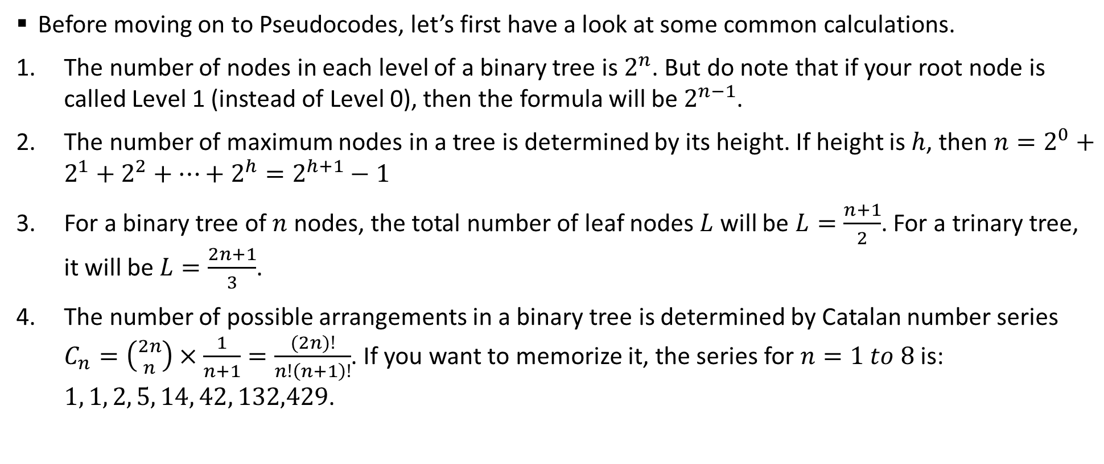
Sample 2
Operations
Before moving on to Pseudocodes, let’s first have a look at some common calculations.
The number of nodes in each level of a binary tree is $2^{n}$. But do note that if your root node is called Level 1 (instead of Level 0), then the formula will be $2^{n−1}$.
The number of maximum nodes in a tree is determined by its height. If height is $h$, then $n=2^{0}+2^{1}+2^{2}+…+2^{h}=2^{h+1}−1$
For a binary tree of $n$ nodes, the total number of leaf nodes $L$ will be $L=\frac{n+1}{2}$. For a trinary tree, it will be $L=\frac{2n+1}{3}$.
The number of possible arrangements in a binary tree is determined by Catalan number series $C_{n}=\left({2n \atop n}\right)×\frac{1}{n+1}=\frac{(2n)!}{n!\left(n+1\right)!}$. If you want to memorize it, the series for $n=1 to 8$ is: $1, 1, 2, 5, 14, 42, 132,429$.

Slide 14
Sample 2
Operations
Traversal
In-order Traversing
Pre-order Traversing
Post-order Traversing
Insertion
Efficient
Complete
Ordered
Deletion
Leaf Node
Parent Node
Depth First and Breath First Search
5019
4669
4930
4901
5040
4910
5144
Traversal | Output
In-order | 4930, 4669, 4901, 5019, 4910, 5040, 5144
Pre-order | 5019, 4669, 4930, 4901, 5040, 4910, 5144
Post-order | 4930, 4901, 4669, 4910, 5144, 5040, 5019

Slide 15
Sample 2
Operations – Traversing
There are several ways to Traverse a tree:
In-order: First, the left child are visited, then parent, and then right child. This is used to traverse the tree in the same order as the nodes where inserted.
Pre-order: First, the parent is visited, then left child, then right child. This is mainly used to create a copy of tree.
Post-order: First, the left child is visited, then right child, then parent. This is mainly used to destroy/clear a tree.
Level-order: First, all nodes on level 1 are visited, then level 2, and so on. When a node is visited, it’s children are put in a queue. The node is then dequeued its children are enqueued in a repeated manner. This is used for Breadth first search.
Moreover, there are other traversal techniques like Boundary and Diagonal traversal.

Slide 16
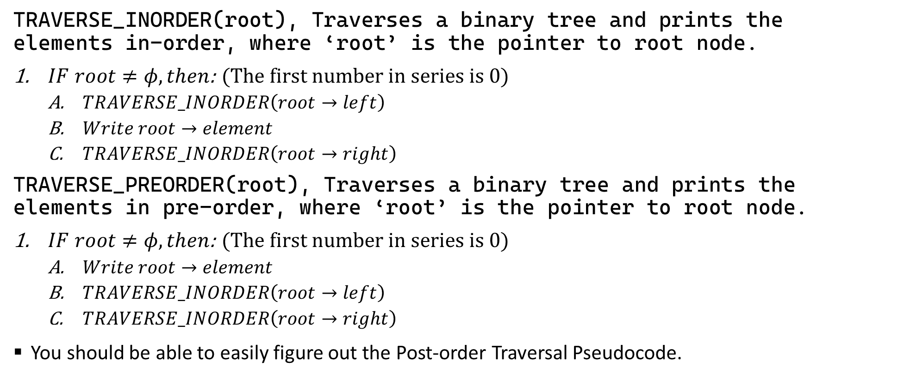
Sample 2
Operations – Traversing
TRAVERSE_INORDER(root), Traverses a binary tree and prints the elements in-order, where ‘root’ is the pointer to root node.
$IF root≠φ, then$: (The first number in series is 0)
$TRAVERSE_INORDER\left(root→left\right)$
$Write root→element$
$TRAVERSE_INORDER\left(root→right\right)$
TRAVERSE_PREORDER(root), Traverses a binary tree and prints the elements in pre-order, where ‘root’ is the pointer to root node.
$IF root≠φ, then$: (The first number in series is 0)
$Write root→element$
$TRAVERSE_INORDER\left(root→left\right)$
$TRAVERSE_INORDER\left(root→right\right)$
You should be able to easily figure out the Post-order Traversal Pseudocode.

Slide 17
Sample 2
Operations – Insertion
Insertion operation in Binary trees can be of multiple types:
Efficient: finds the next available space and inserts the element without respecting the completeness. However, this method makes a Tree unbalanced.
Complete: finds the next available space and inserts the element, while making sure that the last level is complete before creating a new level.
Ordered: finds the most suitable place to insert an element in an ordered tree.

Slide 18
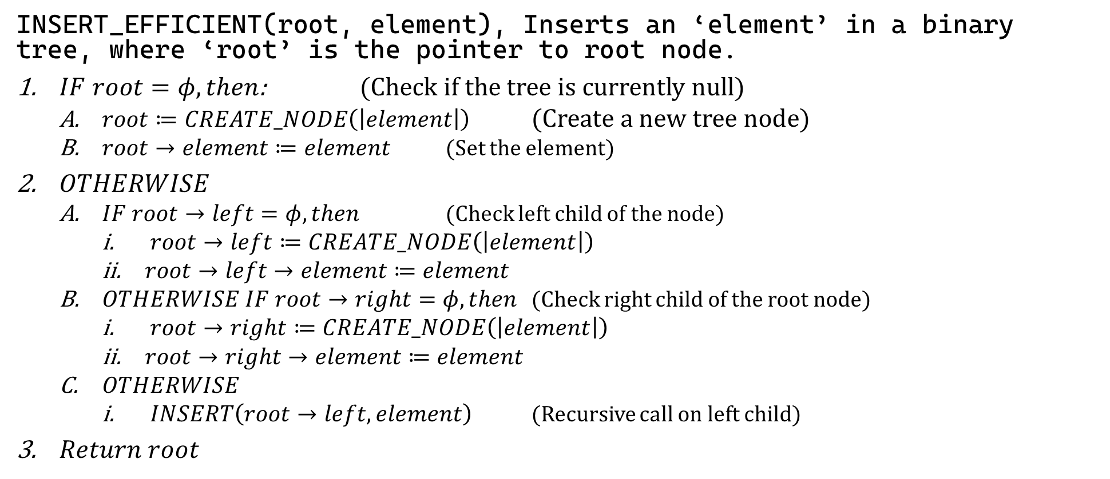
Sample 2
Operations – Insertion
INSERT_EFFICIENT(root, element), Inserts an ‘element’ in a binary tree, where ‘root’ is the pointer to root node.
$IF root=φ, then$: (Check if the tree is currently null)
$root≔CREATE_NODE\left(\left|element\right|\right)$ (Create a new tree node)
$root→element≔element$ (Set the element)
$OTHERWISE$
$IF root→left=φ, then$ (Check left child of the node)
$root→left≔CREATE_NODE\left(\left|element\right|\right)$
$root→left→element≔element$
$OTHERWISE IF root→right=φ, then$ (Check right child of the root node)
$root→right≔CREATE_NODE\left(\left|element\right|\right)$
$root→right→element≔element$
$OTHERWISE$
$INSERT\left(root→left, element\right)$ (Recursive call on left child)
$Return root$
Notes:
In summary, if the root is null, then the element is inserted at root. Otherwise, check for the next “left” space available in the tree hierarchy. If left is not available, then insert at right.

Slide 19
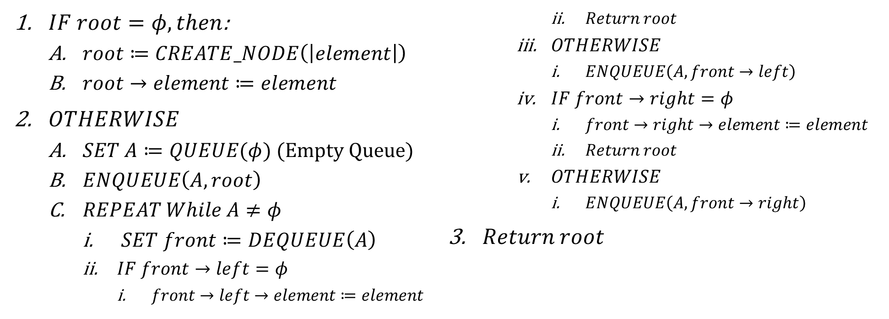
Sample 2
Operations – Insertion
INSERT_COMPLETE(root, element), Inserts an ‘element’ in a binary tree ensuring completeness, where ‘root’ is the pointer to root node.
$IF root=φ, then$:
$root≔CREATE_NODE\left(\left|element\right|\right)$
$root→element≔element$
$OTHERWISE$
$SET A≔QUEUE(φ)$ (Empty Queue)
$ENQUEUE\left(A, root\right)$
$REPEAT While A≠φ$
$SET front≔DEQUEUE\left(A\right)$
$IF front→left=φ$
$front→left→element≔element$
$Return root$
$OTHERWISE$
$ENQUEUE\left(A, front→left\right)$
$IF front→right=φ$
$front→right→element≔element$
$Return root$
$OTHERWISE$
$ENQUEUE\left(A, front→right\right)$
$Return root$
Notes:
In summary, if the root is null, then the element is inserted at root. Otherwise, use a Queue to enqueue left and right children, until the next place in the last level is found. This method creates a new level only when previous level is full.

Slide 20
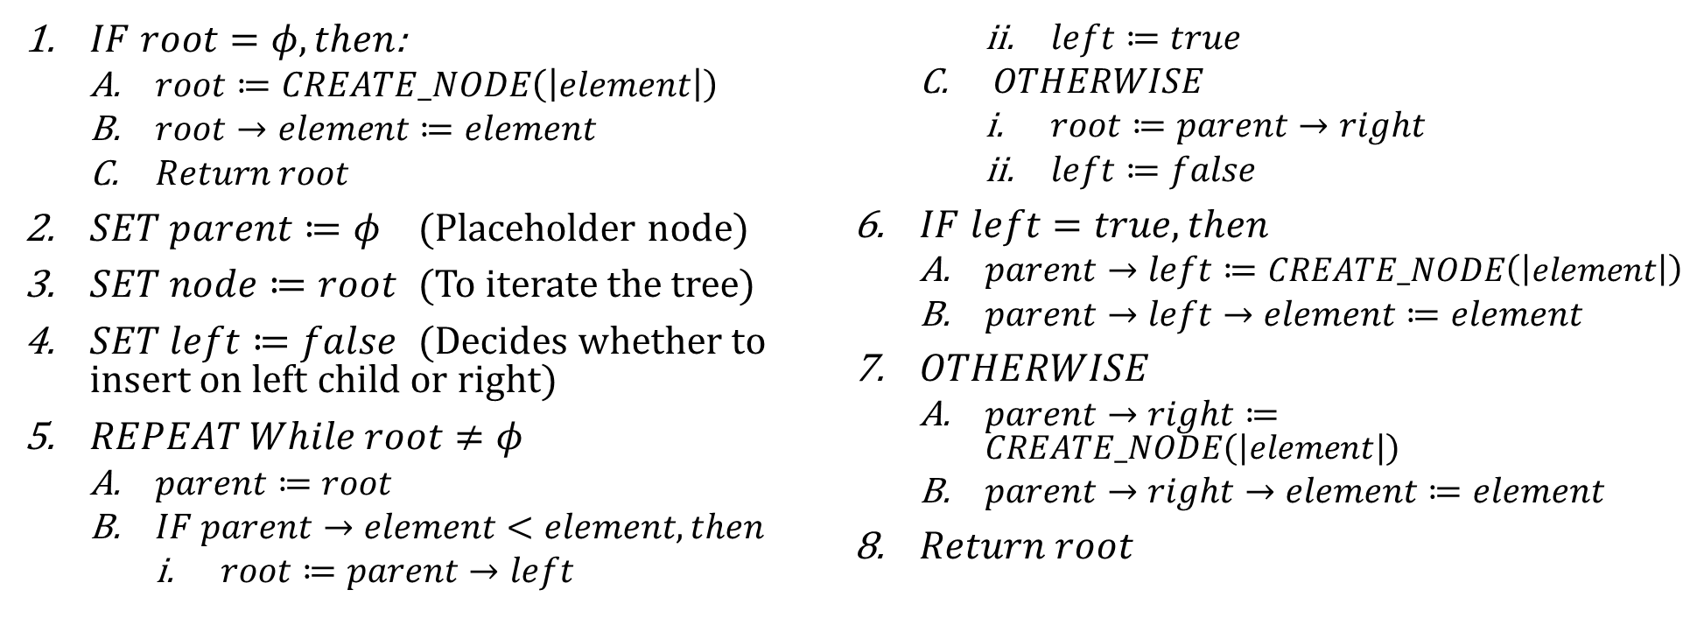
Sample 2
Operations – Insertion
INSERT_ORDERED(root, element), Inserts an ‘element’ in a binary tree in ordered form, where ‘root’ is the pointer to root node.
$IF root=φ, then$:
$root≔CREATE_NODE\left(\left|element\right|\right)$
$root→element≔element$
$Return root$
$SET parent≔φ$ (Placeholder node)
$SET node≔root$ (To iterate the tree)
$SET left≔false$ (Decides whether to insert on left child or right)
$REPEAT While root≠φ$
$parent≔root$
$IF parent→element<element, then$
$root≔parent→left$
$left≔true$
$OTHERWISE$
$root≔parent→right$
$left≔false$
$IF left=true, then$
$parent→left≔CREATE_NODE\left(\left|element\right|\right)$
$parent→left→element≔element$
$OTHERWISE$
$parent→right≔CREATE_NODE\left(\left|element\right|\right)$
$parent→right→element≔element$
$Return root$
Notes:
In summary, if the root is null, then the element is inserted at root. Otherwise, the elements of children are matched. New element is inserted on left side if it’s smaller, otherwise on right side. The “left” variable is a flag which tells whether to move to left side or right side in next iteration. This method also does not maintain completeness or fullness.

Slide 21
Sample 2
Exercise
Jawad: 1000
Left: 1080
Right: 1160
Asra: 1080
Shahzaman: 1160
Left: 1240
Right: 1400
Left: 1320
Right: 1560
Ali: 1240
Hafs: 1400
Omar B: 1320
Uzair: 1560
Left: 1480
Right: Null
Left: Null
Right: Null
Left: Null
Right: Null
Left: Null
Right: Null
Insert a new node “Omar K” while keeping the Tree complete, then dry run for In-order, Pre-order and Post-order traversal and write the output.
Aiman: 1480
Left: Null
Right: Null

Slide 22
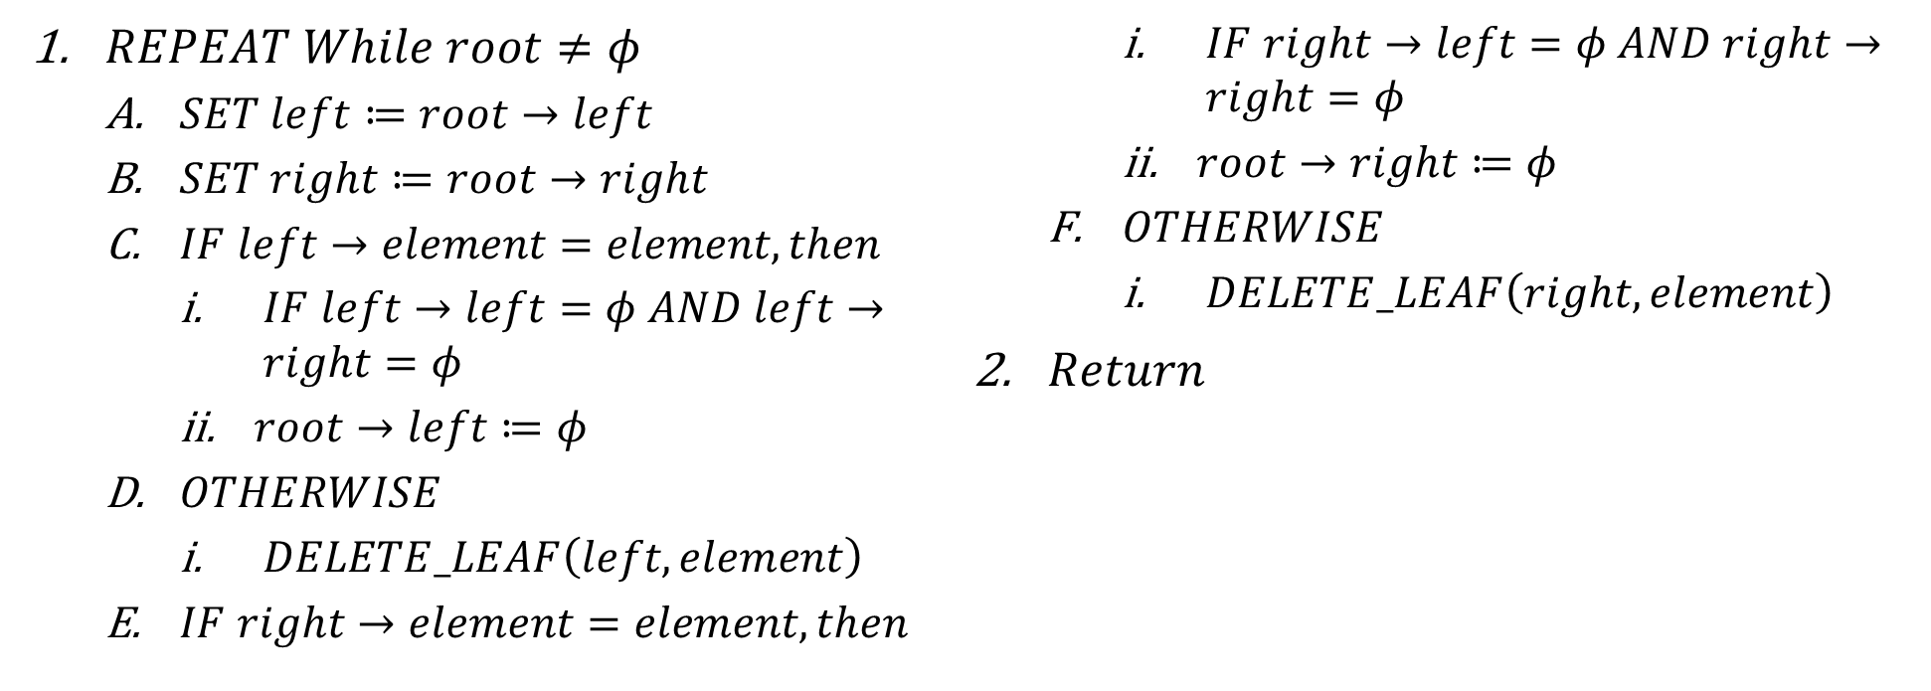
Sample 2
Operations – Deletion
DELETE_LEAF(root, element), deletes a Leaf node from a binary tree by matching element; ‘root’ is the pointer to root node.
$REPEAT While root≠φ$
$SET left≔root→left$
$SET right≔root→right$
$IF left→element=element, then$
$IF left→left=φ AND left→right=φ$
$root→left≔φ$
$OTHERWISE$
$DELETE_LEAF\left(left, element\right)$
$IF right→element=element, then$
$IF right→left=φ AND right→right=φ$
$root→right≔φ$
$OTHERWISE$
$DELETE_LEAF\left(right, element\right)$
$Return$
Notes:
In summary, this method can only be used to delete leaf nodes because deleting leaves do not have any side effects on the tree. The function recursively hunts for the matching element in both left and right branches simultaneously and set the leaf to null only when the data is matching and it has no further children.

Slide 23
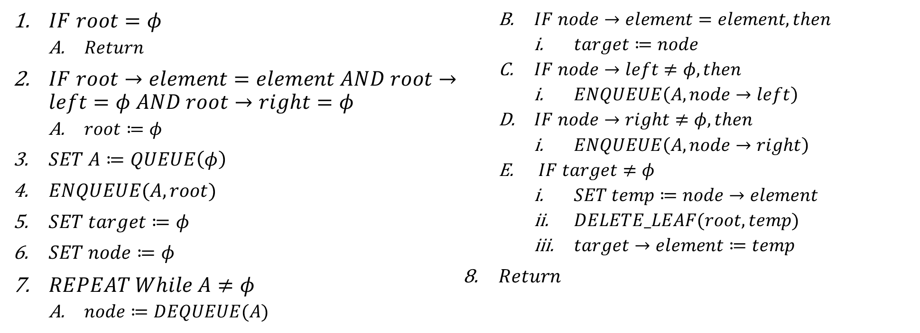
Sample 2
Operations – Deletion
DELETE(root, element), deletes a node from a binary tree by matching element and ensuring completeness; ‘root’ is the pointer to root node.
$IF root=φ$
$Return$
$IF root→element=element AND root→left=φ AND root→right=φ$
$root≔φ$
$SET A≔QUEUE\left(φ\right)$
$ENQUEUE(A,root)$
$SET target≔φ$
$SET node≔φ$
$REPEAT While A≠φ$
$node≔DEQUEUE(A)$
$IF node→element=element, then$
$target≔node$
$IF node→left≠φ, then$
$ENQUEUE\left(A,node→left\right)$
$IF node→right≠φ, then$
$ENQUEUE\left(A,node→right\right)$
$IF target≠φ$
$SET temp≔node→element$
$DELETE_LEAF(root, temp)$
$target→element≔temp$
$Return$
Notes:
The proper way to delete a node. The function first swaps the target node with the deepest rightmost node and then deletes the deepest rightmost node.

Slide 24
Sample 2
Operations
There are mainly 2 types of Searches:
Depth First Search or DFS: this is nothing new, In-order, Pre-order and Post-order are all 3 modes of DFS.
Breadth First Search or BFS: it is also called Level-order because during the traversal (or search) the nodes are visited level-by-level. Therefore, the root node is the first one to be visited, then all of its children, then all grandchildren.
5019
4669
4930
4901
5040
4910
5144
Search | Order of Visiting Nodes if target is 5144
DFS | 5019, 4669, 4930, 4901, 5040, 4910, 5144
BFS | 5019, 4669, 5040, 4930, 4901, 4910, 5144
Notes:
Recall that the difference between Traversing and Search is that Search halts whenever the target element is found.

Slide 25
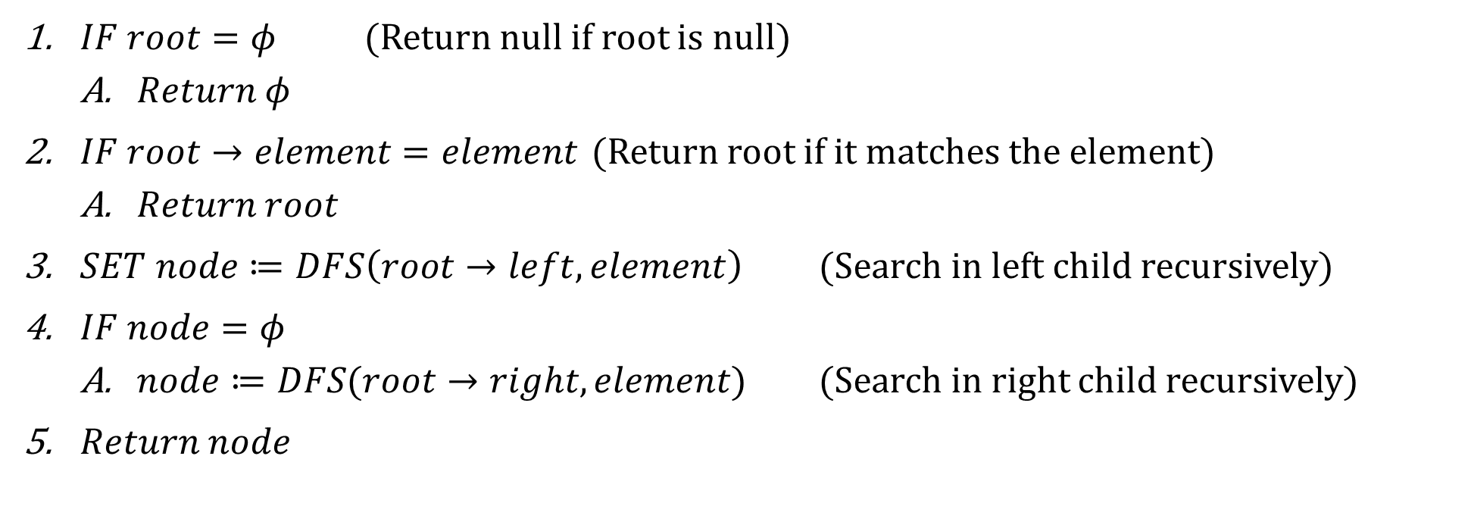
Sample 2
Operations – DFS
DFS(root, element), Searches for the node which matches the ‘element’; ‘root’ is the pointer to root node.
$IF root=φ$ (Return null if root is null)
$Return φ$
$IF root→element=element$ (Return root if it matches the element)
$Return root$
$SET node≔DFS\left(root→left, element\right)$ (Search in left child recursively)
$IF node=φ$
$node≔DFS(root→right, element)$ (Search in right child recursively)
$Return node$

Slide 26
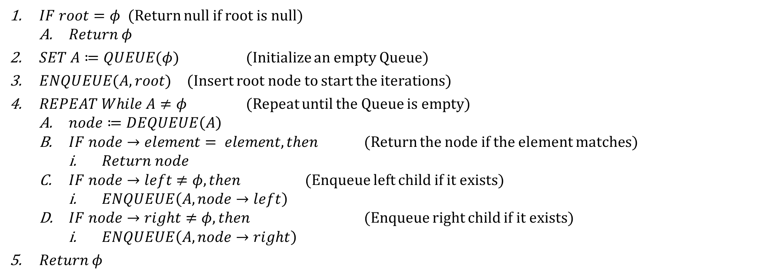
Sample 2
Operations – BFS
BFS(root, element), Searches for the node which matches the ‘element’; ‘root’ is the pointer to root node.
$IF root=φ$ (Return null if root is null)
$Return φ$
$SET A≔QUEUE(φ)$ (Initialize an empty Queue)
$ENQUEUE(A,root)$ (Insert root node to start the iterations)
$REPEAT While A≠φ$ (Repeat until the Queue is empty)
$node≔DEQUEUE\left(A\right)$
$IF node→element= element, then$ (Return the node if the element matches)
$Return node$
$IF node→left≠φ, then$ (Enqueue left child if it exists)
$ENQUEUE\left(A,node→left\right)$
$IF node→right≠φ, then$ (Enqueue right child if it exists)
$ENQUEUE\left(A,node→right\right)$
$Return φ$

Slide 27
Sample 2
Binary Search Tree
Binary Search Tree is a Binary Tree which follows two additional rules:
The elements in the left sub-tree are less than their parent and the elements in the right sub-tree are greater than or equal to their parent.
Duplicate nodes are either not allowed or inserted on the right subtree.
The ordered placement of nodes allows fast Search, Insert and Delete operations.
The INSERT operation is exactly same as INSERT_ORDERED in Binary trees.
SEARCH operation is quite similar, except that it is much faster because we can navigate to the root quickly based on the element’s value.
DELETE operation is relatively different, because when an element is removed, the rearrangement of child nodes must follow the ordering of elements.

Slide 28
Sample 2
Binary Search Tree
INSERT(root, element), Inserts the ‘element’ in ordered binary tree; ‘root’ is the pointer to root node.
See Pseudocode for INSERT_ORDERED operation in Binary Trees.

Slide 29
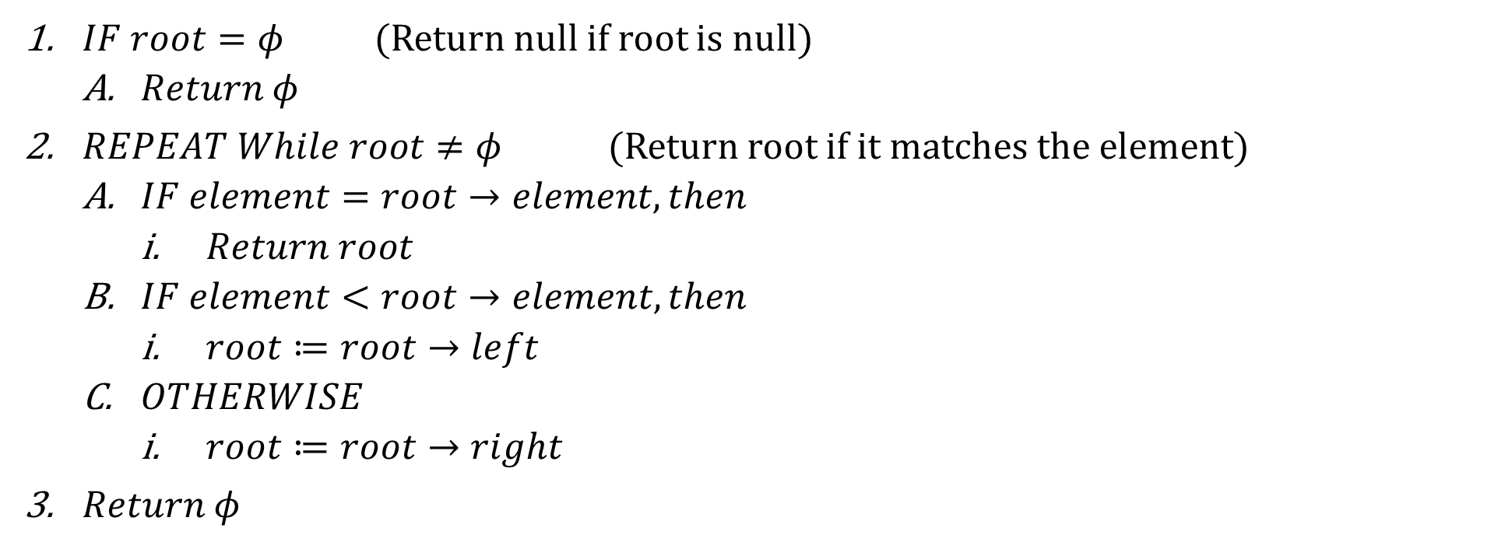
Sample 2
Binary Search Tree
SEARCH(root, element), Searches for the node which matches the ‘element’; ‘root’ is the pointer to root node.
$IF root=φ$ (Return null if root is null)
$Return φ$
$REPEAT While root≠φ$ (Return root if it matches the element)
$IF element=root→element, then$
$Return root$
$IF element<root→element, then$
$root≔root→left$
$OTHERWISE$
$root≔root→right$
$Return φ$

Slide 30
Sample 2
Binary Search Tree
DELETE operation can be understood in 3 cases:
Deleting Leaf node: this is exactly same as DELETE_LEAF operation of Binary Trees.
Deleting a node with single child: SWAP the node with its child and set the node null.
Deleting a node with multiple children: replace with a successor and set the node null. This node should be the leftmost leaf node in the subtree.
In the given example, 5139 is being deleted by replacing with its successor node 5144. We can find the successor using In-order traversal.
5051
5139
4946
4967
5187
4910
5073
5144
5044
5120
5190
5051
5144
4946
4967
5187
4910
5073
5139
5044
5120
5190

Slide 31
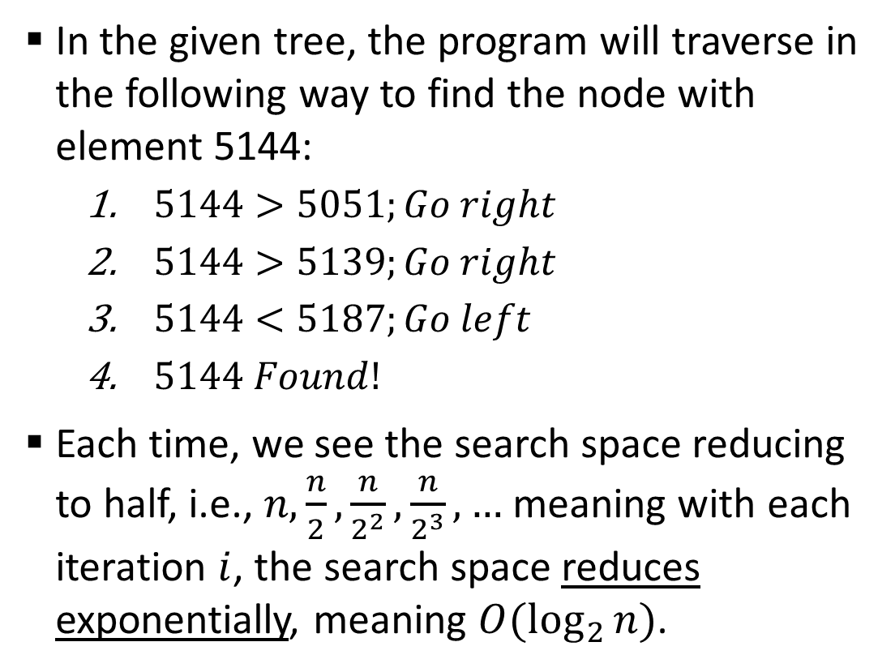
Sample 2
Complexity Analysis
In the given tree, the program will traverse in the following way to find the node with element 5144:
$5144>5051;Go right$
$5144>5139;Go right$
$5144<5187;Go left$
$5144 Found!$
Each time, we see the search space reducing to half, i.e., $n,\frac{n}{2},\frac{n}{2^{2}},\frac{n}{2^{3}},…$ meaning with each iteration $i$, the search space reduces exponentially, meaning $O(\log_{2}{n)}$.
5051
5139
4946
4967
5187
4910
5073
5144
3826
3045
4901
5044
5120
5190
Iteration | Search space
1 | 14 nodes
2 | 7 nodes
3 | 3 nodes
4 | 1 node

Slide 32
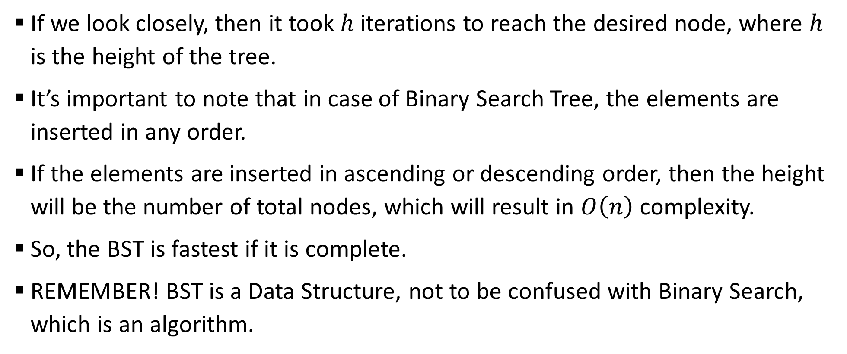
Sample 2
Binary Search Tree
If we look closely, then it took $h$ iterations to reach the desired node, where $h$ is the height of the tree.
It’s important to note that in case of Binary Search Tree, the elements are inserted in any order.
If the elements are inserted in ascending or descending order, then the height will be the number of total nodes, which will result in $O\left(n\right)$ complexity.
So, the BST is fastest if it is complete.
REMEMBER! BST is a Data Structure, not to be confused with Binary Search, which is an algorithm.

Slide 33
Sample 2
In Real Life
BST can be used to maintain a large dataset with millions of nodes without compromising the performance of Insert and Search.
A modified version of BST, called Self-balancing BST keeps the tree in complete form. These BSTs are the most efficient.
Database indexing widely uses BST to make the Data Querying much faster.
Binary Heaps, which are used to implement Priority Queues are a specialized form of BSTs.
Compiles use BSTs to store the list of symbols and functions in memory for rapid recalling.

Slide 34
Sample 2
DIY
Following the source code of Binary Trees and Slides from this presentation, implement a complete BST from scratch, providing the following operations:
INSERT
SEARCH
DELETE (all 3 cases)

Slide 35



THANK YOU
Owais Hussain
+92 345-3174270
owais.hussain@kiet.edu.pk
https://www.researchgate.net/profile/Owais-Hussain-3

